Slide 1
DBMS Project Team No. 15 Assignment-2,3
Team Members: Ajay Ghiyad(19BCP003)
Deep Patel(19BCP023)
Hansil Jasoliya(19BCP044)
Hariaum Babaria(19BCP046)
Harsh Vachhani(19BCP047)
Saumya Rangani(19BCP118)

Slide 2
Summary:
(1) Our model consists the data of NYSE, NSE and BSE markets.
(2) In this model user can see the current price of the stocks of the respective company.
(3) This model consists the feature in which user’s interested stocks can be tracked and analysed.
(4) User can add or remove the stocks of his interested company using our model.
(5) If user has invested in any stocks then our model will track the price at which the user bought stocks and also the stock’s quantity. So, our model can display whether he has earned profit or not from that stock.
(6) If the user wants to sell his stocks then our model will show how much profit he/she can earn so that he can think whether he/she wants to sell that particular stock or not.
(7) Our model tracks the record of all the transactions made by the user. Our model also tracks the yearly records of all the stocks.
(8) Our model shows the IPO company name, IPO listing date and IPO issue size.
(9) Our model tracks the records of IPO user’s profit and loss, IPO user’s investment/selling date and IPO last traded price.
(10) Our model also tracks the record of total profit-loss of IPO and stock combined.

Slide 3
Comparison:
No. | Feature Description | Table
1. | Listing of vast range of companies in different stock market i.e. BSE, NYSE, NSE. | Company_detail, Company_BSE, Company_NSE, Company_NYSE
2. | Data of recent IPOs, upcoming IPOs. | IPO_company, IPO_value
3. | Accurate in depth value of stocks | Stock_daily_value, Stock_yearly_value, Stock_current_value
4. | Track the user details i.e. Pan card, Dmat account id | User, Stock_user, IPO_user
5. | Track stock interest of the user | Stock_user_interest
6. | Track the transaction of user like selling and invest | Stock_user_invest, Stock_user_sell_value, IPO_user_investment, IPO_user_selling,
7. | Track the selling and invest history of the user | Stock_user_invest_history, Stock_user_selling_history, IPO_user_invest_history, IPO_user_selling_history
8. | Show user the profit or loss by IPO and stock | Stock_user_profit_loss, User_total_profit_loss, IPO_user_profit_loss

Slide 4
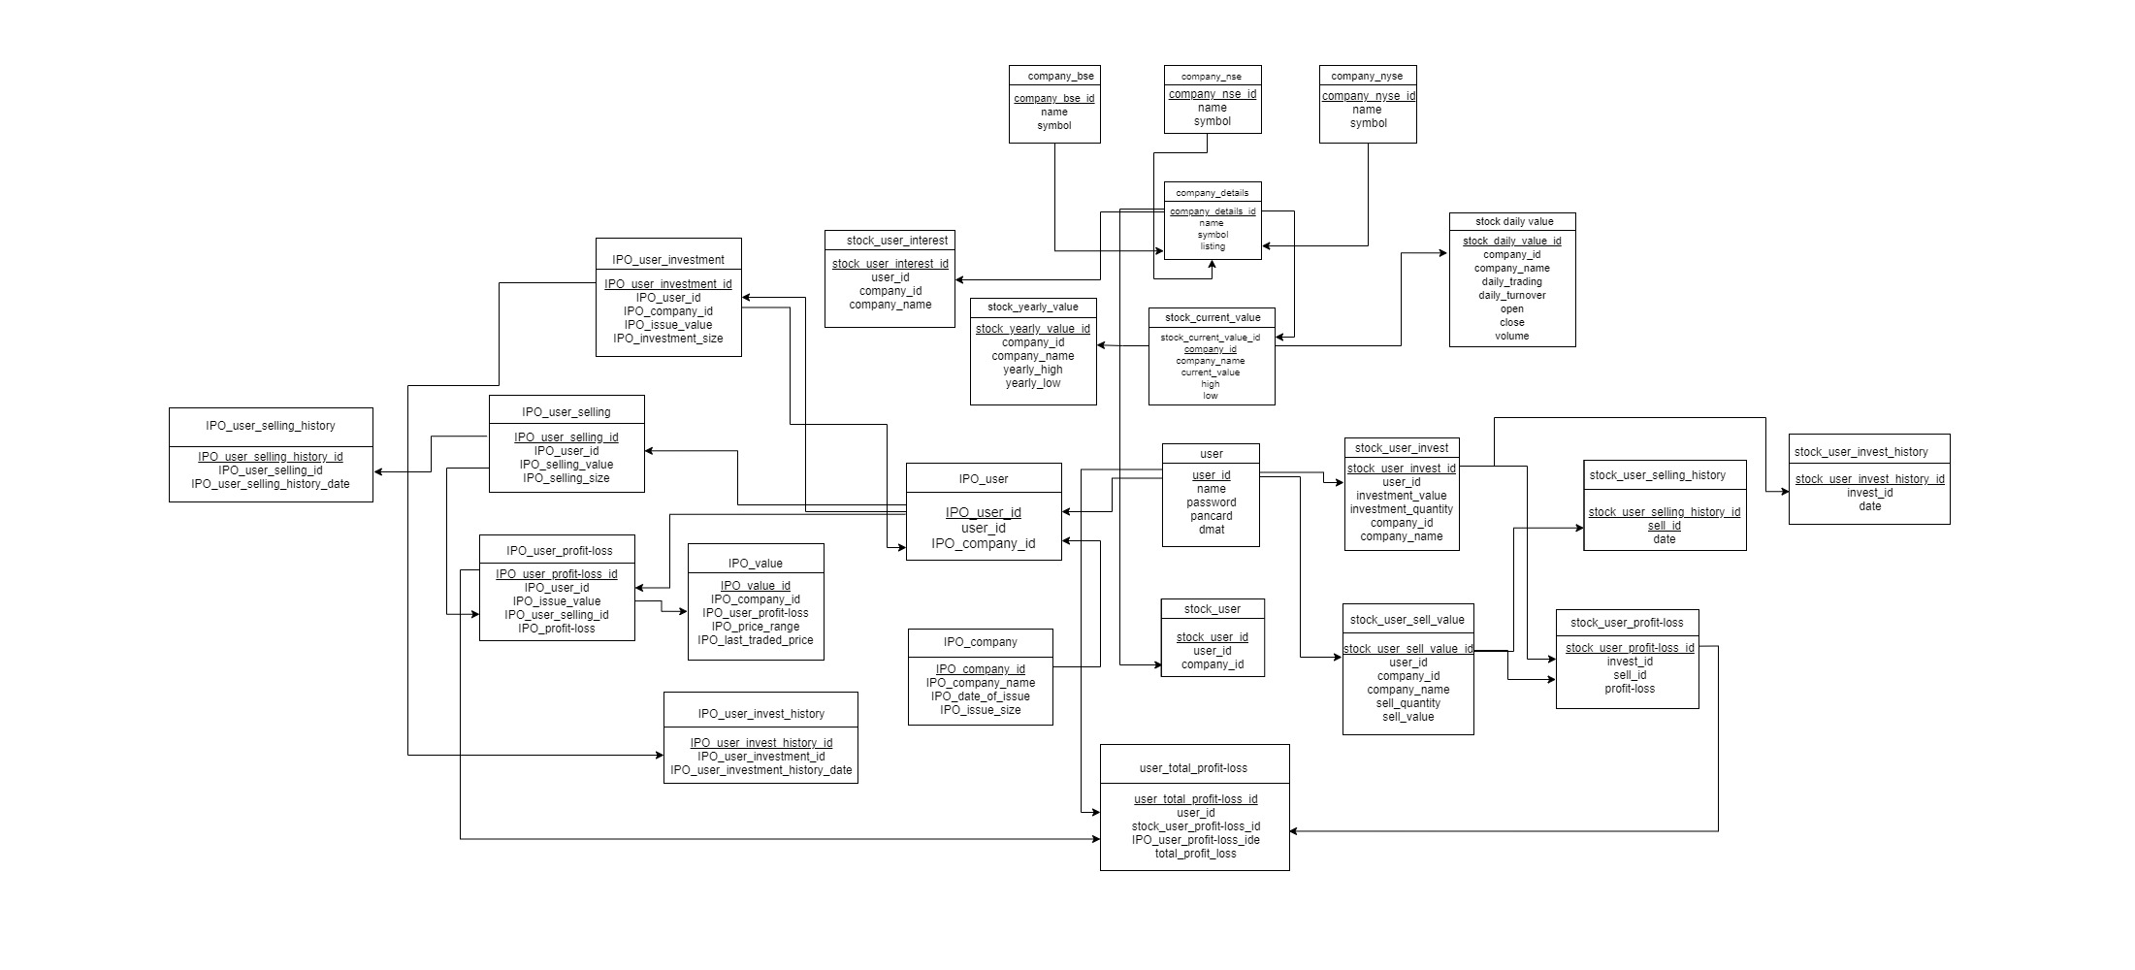
Relational Model
Relational Model

Slide 5
Sr No | Table Name | Primary key | Foreign key | Candidate key | Super key
1 | Company_BSE | Company_BSE_id | - | Symbol | Name, Symbol
2 | Company_NSE | Company_NSE_id | - | Symbol | Name, Symbol
3 | Company_NYSE | Company_NYSE_id | - | Symbol | Name, Symbol
4 | Company_detail | Company_detail_id | listing | Symbol | Name, listing
5 | Stock_current_value | Stock_current_value_id | Company_detail_id | Current_value | Company_name, high, low
6 | Stock_daily_value | Stock_daily_value_id | Company_detail_id | Daily_turnover, Daily_trading | Company_name,open, close
7 | Stock_yearly_value | Stock_yearly_value_id | Company_detail_id | Company_name | Yearly_high, Yearly_low
8 | User | User_id | - | Dmat | Pancard,Dmat
9 | Stock_user | Stock_user_id | User_id | Company_id | User_id, Company_id
10 | Stock_user_invest_value | Stock_user_invest_value_id | User_id | User_id, Stock_user_invest_value_id | Stock_user_invest_value_id Company id User id
11 | Stock_user_sell_value | Stock_user_sell_value_id | User_id | User_id, Stock_user_sell_value_id | Stock_user_sell_value_id Company id User id
12 | Stock_user_profit_loss | Stock_user_profit_loss_id | Stock_user_Invest_id, Stock_user_sell_id | Stock_user_Invest_id, Stock_user_sell_id | Stock_user_Invest_id Stock_user_sell_id

Slide 6
Sr No | Table Name | Primary key | Foreign key | Candidate key | Super key
13 | Stock_user_invest_history | Stock_user_invest_history_id | Stock_user_invest_value_id | Stock_user_invest_value_id | Stock_user_invest_value_id
14 | Stock_user_sell_history | Stock_user_sell_history_id | Stock_user_sell__value_id | Stock_user_sell_value_id | Stock_user_sell_value_id
15 | IPO_company | IPO_company_id | - | IPO_company_id IPO_date_of_issue | IPO_company_id IPO_date_of_issue
16 | IPO_user | IPO_user_id | User_id, IPO_company_id | User_id, IPO_company_id | User_id IPO_Company_id
17 | IPO_value | IPO_value_id | IPO_company_id,IPO_issue_value | IPO_company_id | IPO_company_id IPO_issue_value IPO_price_range
18 | IPO_user_investment | IPO_user_investment_id | IPO_user_id, IPO_company_id,IPO_issue_value | IPO_user_investment_id, IPO_Company_id | IPO_user_investment_id IPO_Company_id
19 | IPO_user_selling | IPO_user_sell_id | IPO_user_id, IPO_company_id,IPO_issue_value | IPO_user_sell_id, IPO_Company_id | IPO_user_sell_id IPO_Company_id
20 | IPO_user_profit_loss | IPO_user_profit_loss_id | IPO_user_id, IPO_user_selling_id, IPO_value_id | IPO_value_id, IPO_user_profit-loss_id | IPO_user_selling_id IPO_user_profit_loss_id
21 | IPO_user_selling_history | IPO_user_selling_history | IPO_user_selling_id | IPO_user_selling_id, IPO_user_selling_history_id | IPO_user_selling_id IPO_user_selling_history_id IPO_user_selling_history_date
22 | IPO_user_invest_history | IPO_user_investment_history | IPO_user_investment_id | IPO_user_investment_id, IPO_user_investment_history_id | IPO_user_investment_id IPO_user_investment_history_id IPO_user_investment_history_date
23 | Stock_user_interest | Stock_user_interest_id | User_id | Stock_user_interest_id | Stock_user_interest_id Company_id
24 | User_total_profit_loss | User_total_profit_loss_id | User_id,Stock_user_profti_loss_id,IPO_user_profti_loss_id | Stock_user_profti_loss_id,IPO_user_profti_loss_id | User_id Stock_user_profti_loss_id IPO_user_profti_loss_id

